Slide 1
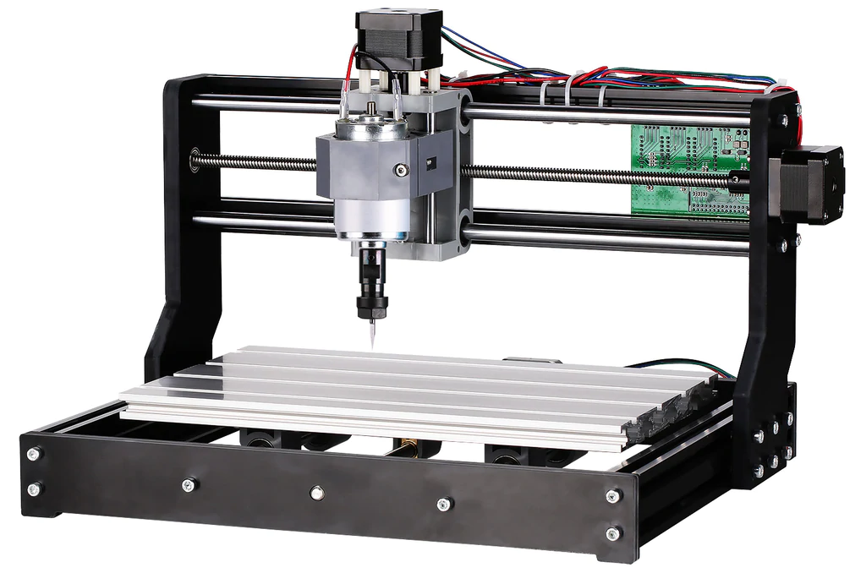
ECE 544 Final Project Manual CNC Cutting Machine
Alex Beaulier, Josiah Sweeney - June 8th, 2022

Slide 2
Summary
Functional Overview
IP Development
Physical System
Hardware and Circuit Diagram
FreeRTOS
Demo
QA

Slide 3
Functional Overview
Manual CNC Cutting machine
Each axis is driven by a stepper motor for full XYZ motion for an end of arm tooling(EOAT) to be used.
OLED displaying XYZ coordinates.
PMOD Joystick for manual movement in XY directions.
Buttons for movement in Z direction
Switches for triggering Watchdog shutdown and turning on the EOAT
EAOT wired to Relay integrated on PMOD port with emergency switch.
FreeRTOS OS for control of machine.
Notes:
Alex

Slide 4
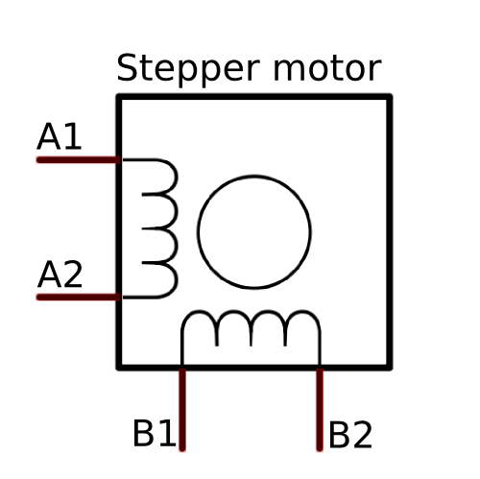
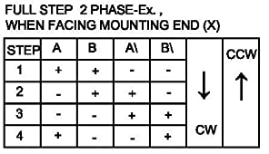
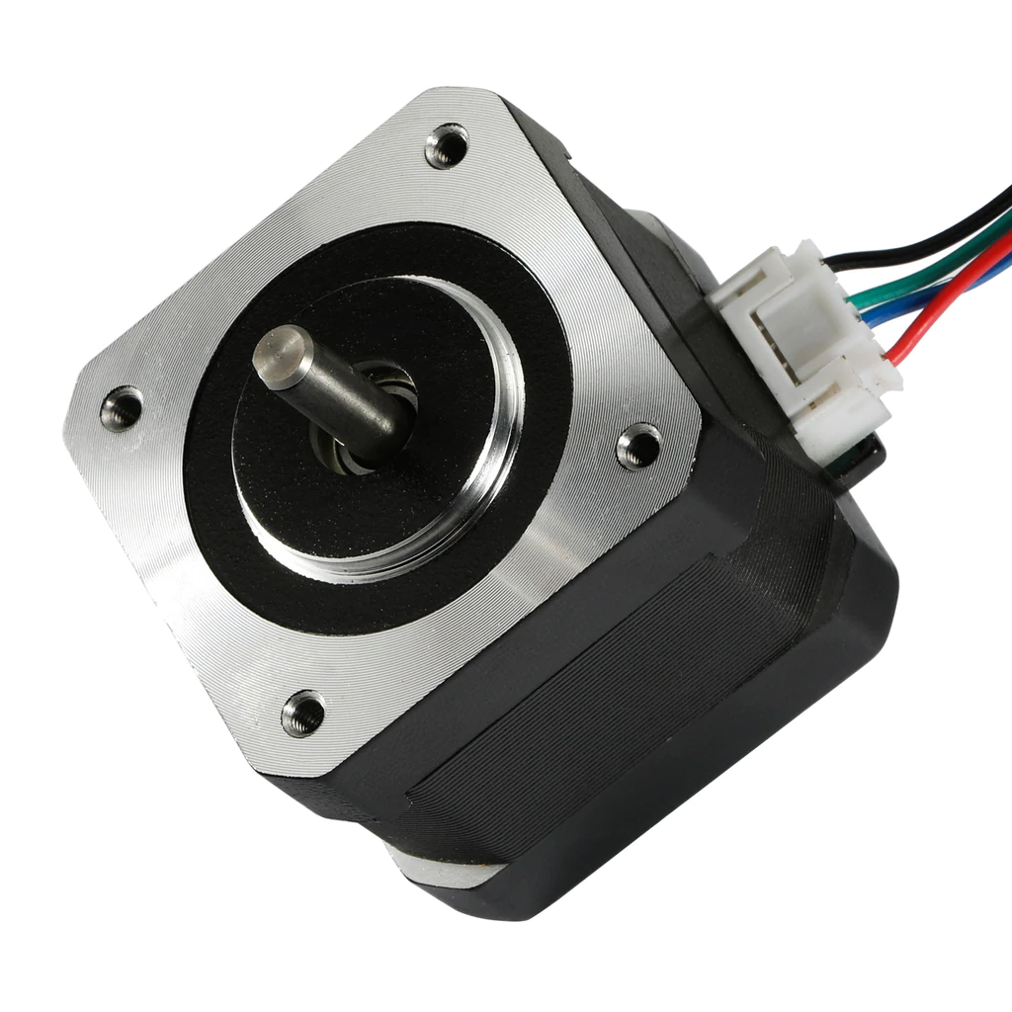
IP Development
There is no pre-existing IP for the PMOD Step, used to drive the 3 stepper motors, thus IP had to be created.
Notes:
Tried driving both two pole and single pole
Varied frequency for operation and voltages
Datasheet 600mA continuous draw 1.2A max briefly, motors can draw xyz from testing

Slide 5
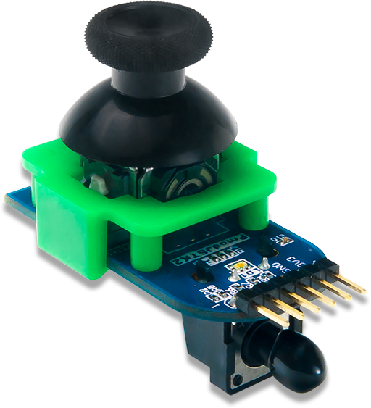
IP Development
IP Imported for Joystick
Uses SPI Communication
Returns 8-bit XY position
https://digilent.com/reference/pmod/pmodjstk2/reference-manual
Notes:
Tried driving both two pole and single pole
Varied frequency for operation and voltages
Datasheet 600mA draw 1.2A max briefly, motors can draw xyz from testing

Slide 6
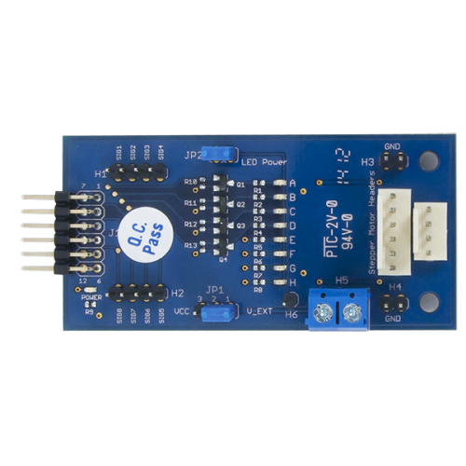
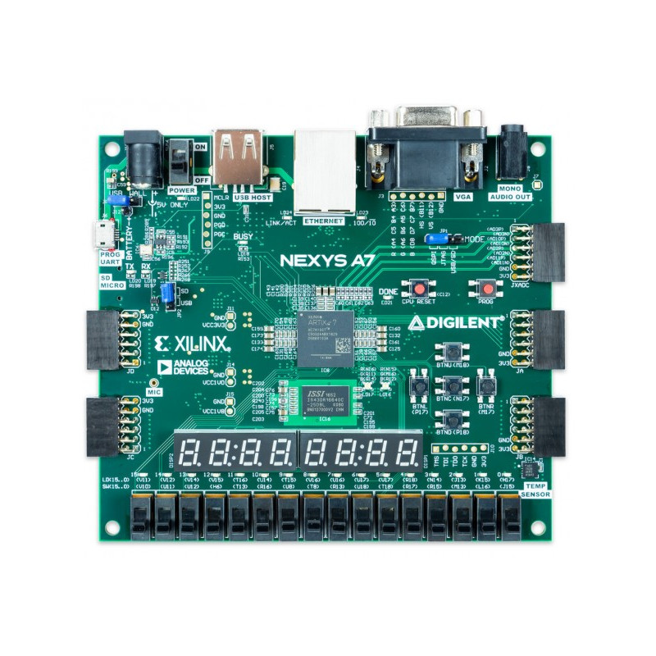
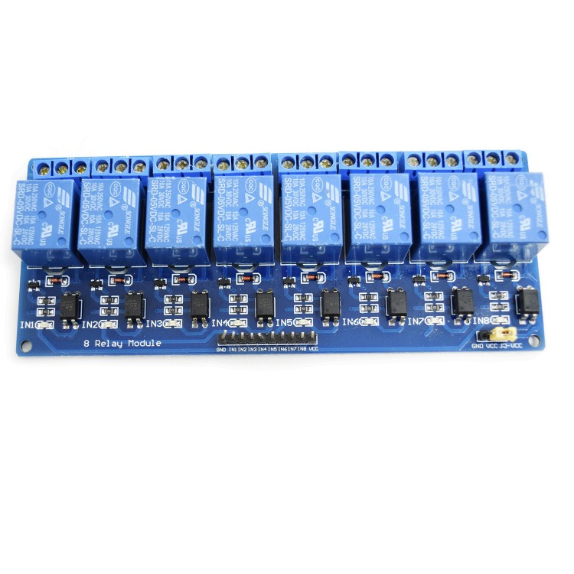
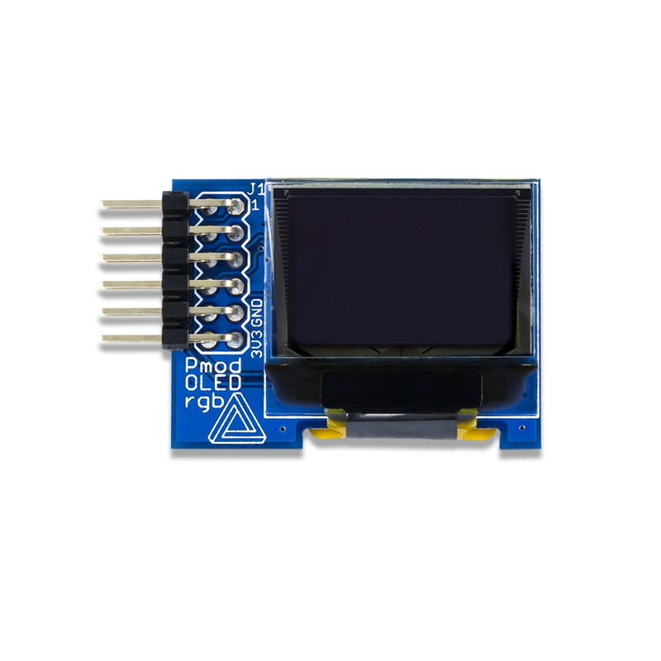
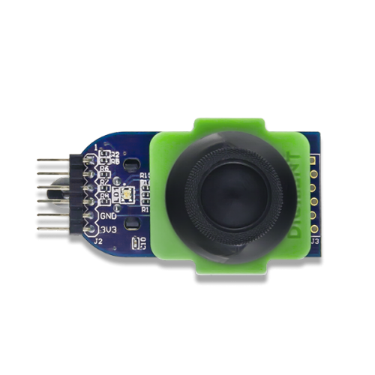
Physical Layout - Nexys A7
JA - Relay pin 7
JB - PMOD OLED
JC - Joystick Top Row, Z Axis Bot Row
JD - Y Axis Top Row, X Axis Bot Row

Slide 7
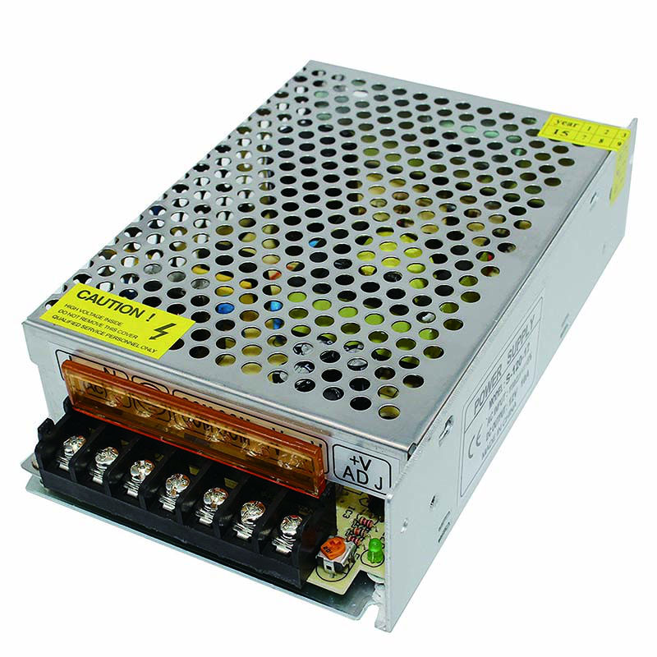
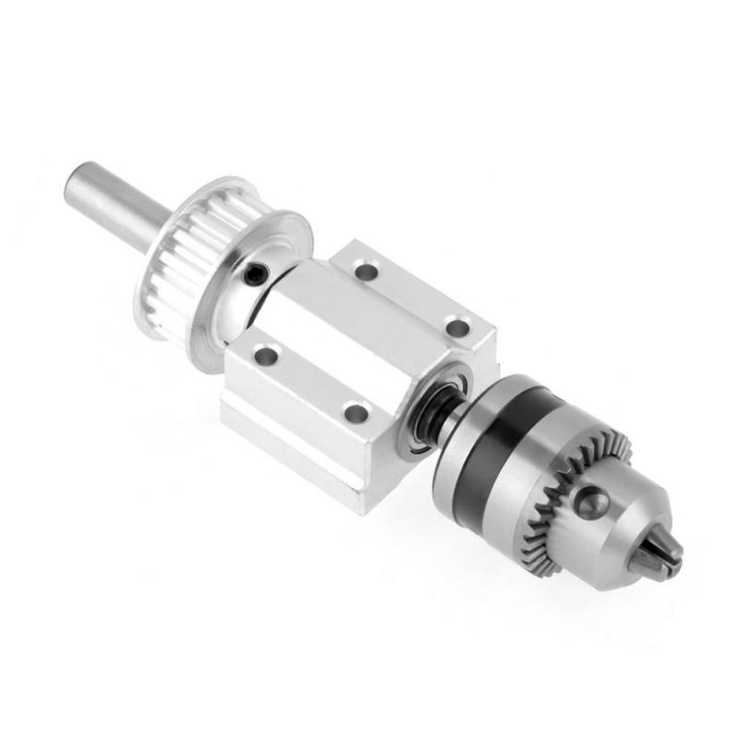
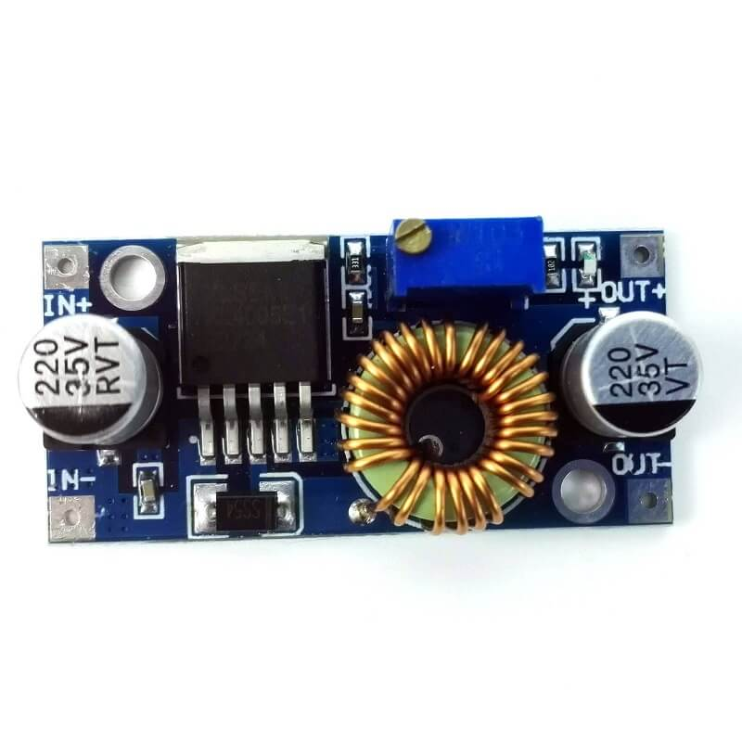
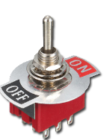
Physical Layout - Relay
Active low output, single pin
Added buck converter from 12V supply
Added secondary emergency switch
Insert Image here

Slide 8
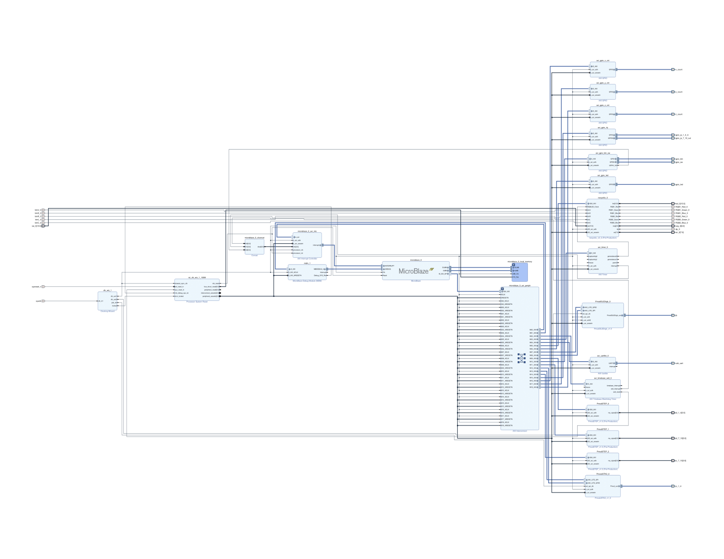
Hardware Diagram
Hardware Design Includes:
6 GPIOs
X,Y,Z Buttons,
Relay, LED
3 PMODSteps
1 PMODJSTK2
1 Nexys4io
1 PMODOLEDrgb
1 WDT
1 UartLite

Slide 9
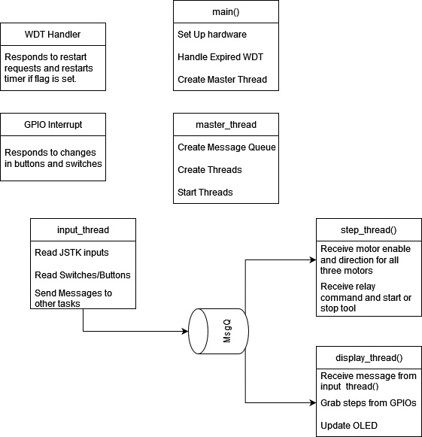
RTOS Tasking Background
For this project, we used a similar threading model to project 3, as this was similar in concept, but just more motor control.

Slide 10

Demo

Slide 11
BackUp Video

Slide 12
QA

